Slide 1
Developing Servlets

Slide 2

The Servlet Programming Model
Overview
Servlet class hierarchy
The Servlet Service methods
HttpServletRequest and HttpServletResponse
Servlet Context
HttpSession

Slide 3






Evolution of Servlets
May 1996
Announced
JavaOne
June 1997
Servlet 2.1
JWSDK
2005
Servlet 2.5
JEE/JSE 5
2013
Servlet 3.1
JEE/JSE 7
2019
Servlet 4.0
Jakarta EE 8
1999
Servlet 2.1
Tomcat
2009
Servlet 3.0
JEE/JSE 6
2017
Servlet 4.0
JEE/JSE 8
Dec 1996
Servlet 1.0
Jeeves Alpha

Slide 4
Evolution of Servlets
Jakarta Servlets
May 1996 June 1997 2005 2013
_{Announced} Servlet 2.1 Servlet 2.5 Servlet 3.1
_{JavaOne} JWSDK JEE/JSE 5 JEE/JSE 7
2019
Servlet 4.0
Jakarta EE 8
₁₉₉₉ ₂₀₀₉ 2017
_{Servlet 2.1 Servlet 3.0} Servlet 4.0
_{Tomcat JEE/JSE 6} JEE/JSE 8
Dec 1996
Servlet 1.0
Jeeves Alpha
The Java Servlet API

Slide 5
The Servlet Class

Slide 6

Servlet Primary Purpose
Input Stream
Output Stream

Slide 7
HttpServlet Class Diagram
javax.Servlet
Jakarta Servlet API
<<Abstract>>
Generic Servlet

Slide 8
HttpServletRequest Class Diagram
javax.Servlet
<<Abstract>>
GenericServlet
Jakarta Servlet API
<<Abstract>>
HttpServlet

Slide 9
HttpServletRequest Class Diagram
javax.Servlet
<<Abstract>>
GenericServlet
Jakarta Servlet API
<<Abstract>>
HttpServlet
com.example
Servlet Container
Developer Servlet

Slide 10
HttpServletRequest Class Diagram
javax.Servlet
Jakarta Servlet API
<<Abstract>>
Generic Servlet

Slide 11
Developing a Simple Servlet

Slide 12
Working with HTTP Parameters

Slide 13
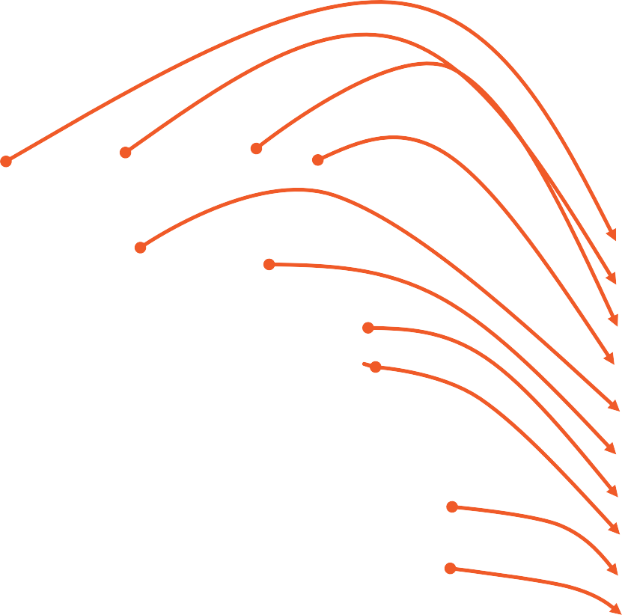
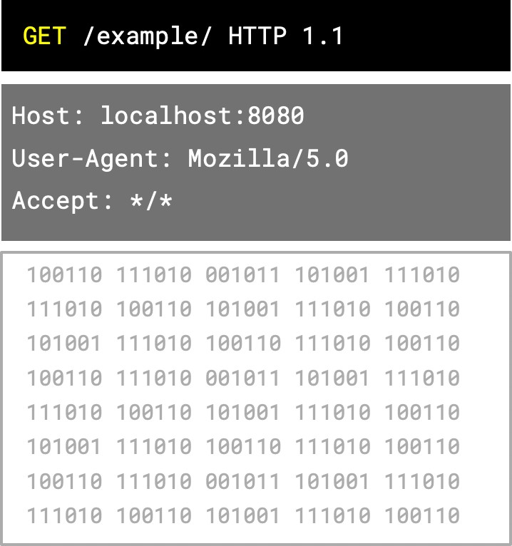
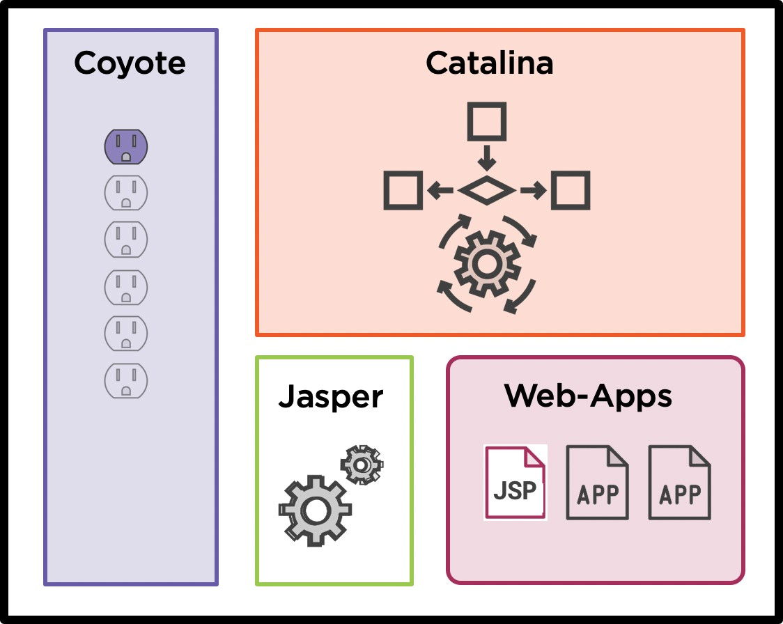

HttpServletRequest
HttpServletRequest
getMethod() getContextPath() getProtocol() getParameter() getServerName() getServerPort() getCookies() getHeader(name)
getInputStream() getParts()
getServerInfo() getSession() getServletContext()

Slide 14
Working with HTTP Headers

Slide 15
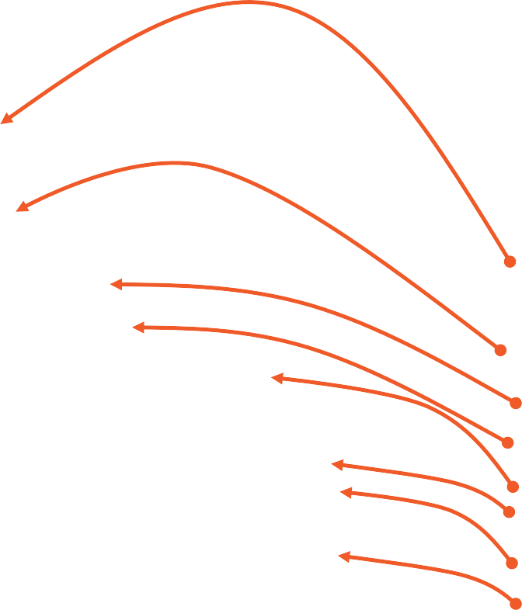
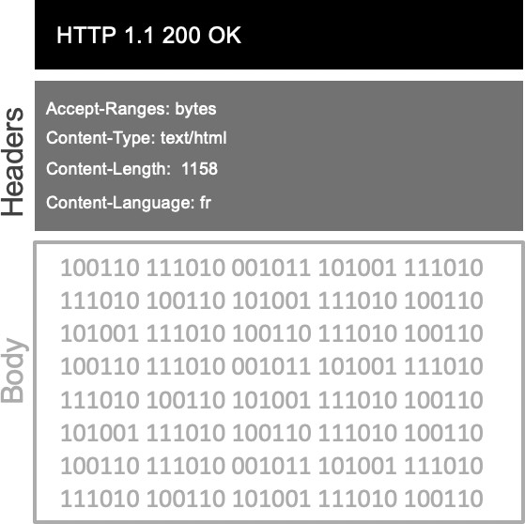
HttpServletResponse
HttpServletResponse
setStatus() addIntHeader() addHeader() setContentType() setLocale() addCookie() setCharacterEncoding()
getWriter() setBufferSize()

Slide 16
Accept-Language Header on HTTP Request
GET /example/ HTTP 1.1
Headers
Host: localhost:8080 User-Agent: Mozilla/5.0
Accept-Language: fr-FR, en-US, de
100110 111010 001011 101001 111010
111010 100110 101001 111010 100110
101001 111010 100110 111010 100110
100110 111010 001011 101001 111010
111010 100110 101001 111010 100110
101001 111010 100110 111010 100110
100110 111010 001011 101001 111010
111010 100110 101001 111010 100110
Body

Slide 17
Content-Language Header on HTTP Response
HTTP 1.1 200 OK
Headers
Accept-Ranges: bytes
Content-Type: text/html Content-Language: fr
100110 111010 001011 101001 111010
111010 100110 101001 111010 100110
101001 111010 100110 111010 100110
100110 111010 001011 101001 111010
111010 100110 101001 111010 100110
101001 111010 100110 111010 100110
100110 111010 001011 101001 111010
111010 100110 101001 111010 100110
Body

Slide 18
Working with the Servlet Context

Slide 19






ServletContext Interface to Container
Catalina Engine
ServletContexts
CTX
CTX
CTX
Servlets
SERVLET
SERVLET
SERVLET

Slide 20
ServletContext Interface to Container
CTX
SERVLET
counter = 7
Catalina Engine
ServletContexts
Servlets

Slide 21
ServletContext Interface to Container
Catalina Engine
ServletContexts
CTX
Servlets
SERVLET
counter = 3
SERVLET
counter = 7
SERVLET
counter = 0

Slide 22
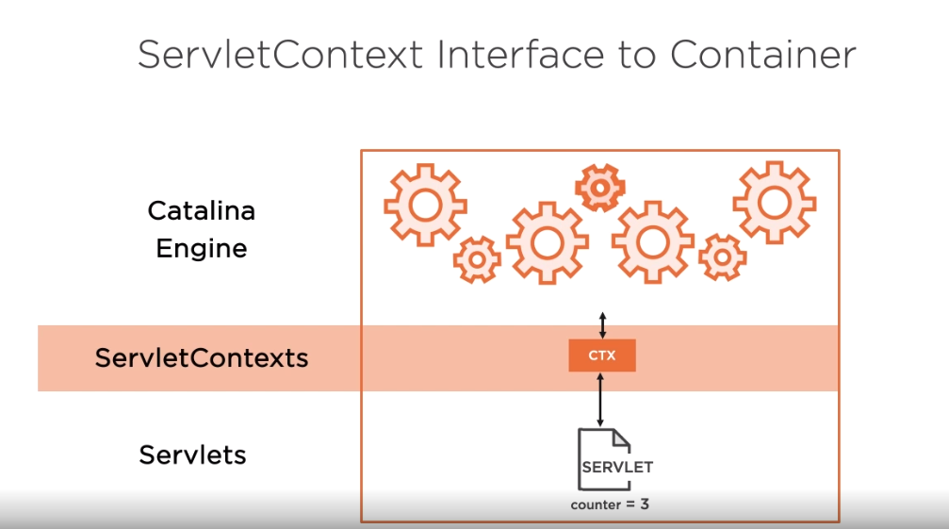

Slide 23
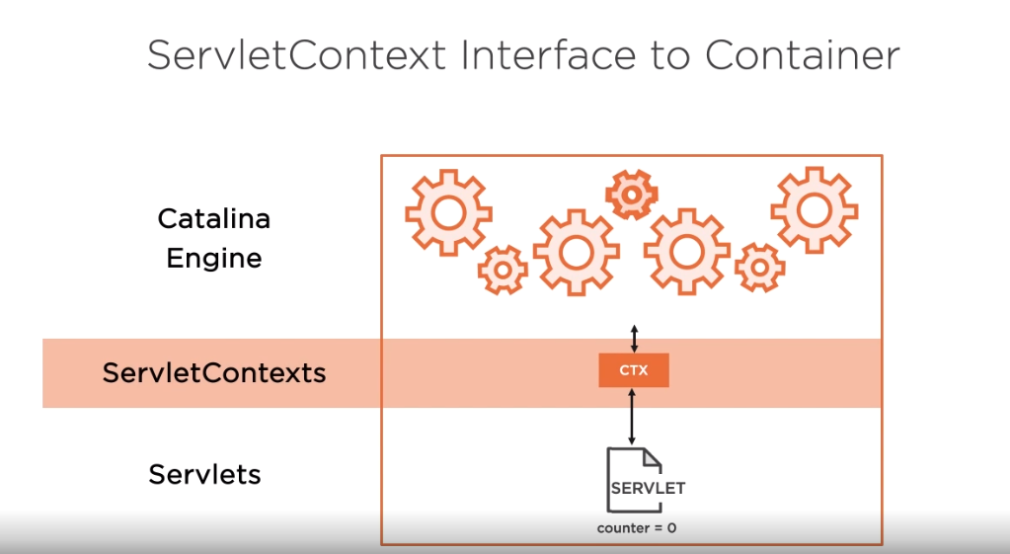

Slide 24
Working with the HttpSession

Slide 25







ServletContext Interface to Container
Client
B
Catalina Engine
Client A
Session B
HttpSessions
Session A
Servlets
SERVLET
SERVLET
SERVLET

Slide 26
ServletContext Interface to Container
Client
B
Catalina Engine
Client A
HttpSessions
Session A
Session B
Servlets
SERVLET
SERVLET
SERVLET

Slide 27
ServletContext Interface to Container
Client
B
Catalina Engine
Client A
HttpSessions
Session A
Session B
Servlets
SERVLET
SERVLET
SERVLET

Slide 28
ServletContext Interface to Container
Client
B
Catalina Engine
Client A
Session B
HttpSessions
Session A
Servlets
SERVLET
SERVLET
SERVLET

Slide 29
ServletContext Interface to Container
Client
B
Catalina Engine
Client A
HttpSessions
Session A
Session B
Servlets
SERVLET
SERVLET
SERVLET

Slide 30



Session Tracking Solutions
Cookies
Hidden Form Files
URL Rewriting

Slide 31

Mechanisms for Session Timeout
HttpSession.invalidate()
Tomcat configured
30 min
Web.xml configured
Annotation declared

Slide 32
The Servlet Programming Model
Servlets are derived from HttpServlet
Servlet doGet( )
HttpServletRequest
HttpServletResponse
ServletContext
HttpSession
Servlets are usually single, stateless, concurrent instances
Next:
Working with JSPs
Summary

